Slide 1
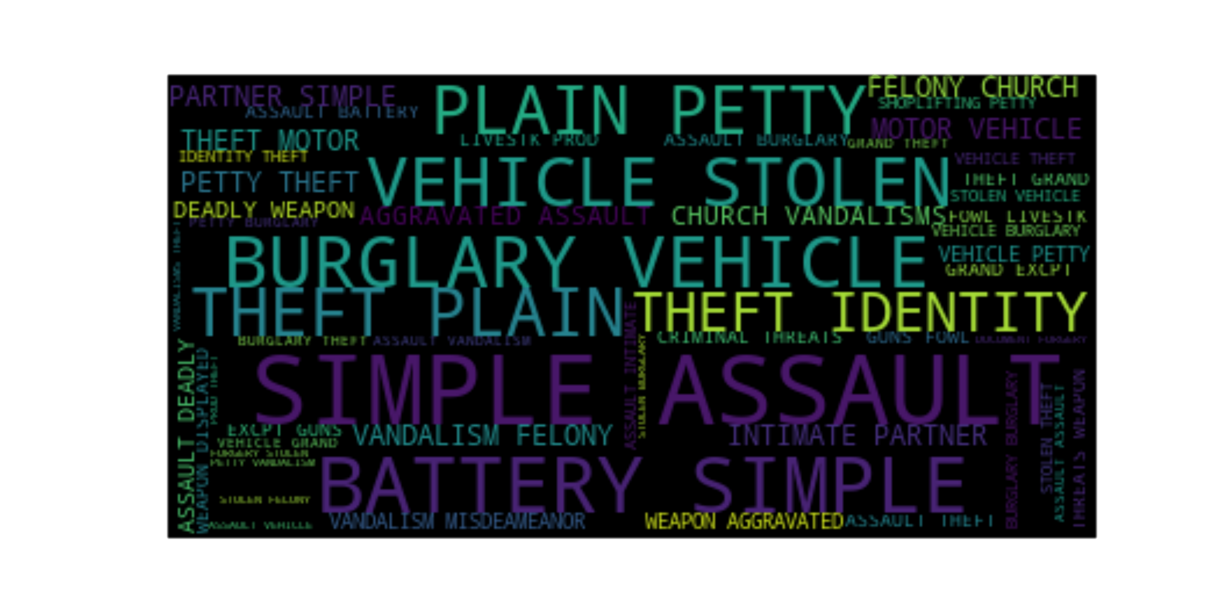
Rice University Data Analytics Boot Camp
Project 1 - Information, Insights, and Analysis from the City of Los Angeles – Crime – 2010 through 2018
Frederik De Bruyker / Ehsan Khan / Jeff Mackey

Slide 2
Strong Disparity by Zip Code
169 zip codes
10% of top violent crimes zip codes account for 43.66 % of total violent crimes
20 % of top violent crimes zip codes account for 65.19 % of total violent crimes

Slide 3
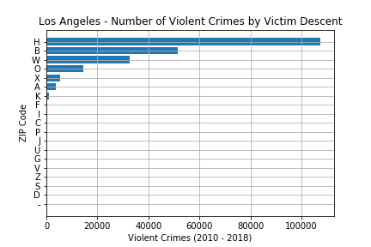
Expectation versus Data: Victim Descent
Expectation: expected % of Hispanic / Black victims to be close
Data:
49.56 % of violent crime victims are of Hispanic descent
Black / White crime are not that dramatically different
Descent | Percentage
Hispanic | 49.56%
Black | 23.80%
White | 15.10%

Slide 4
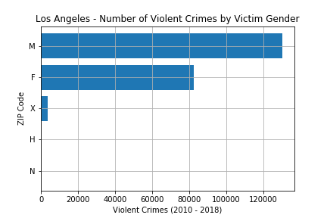
Expectation versus Data: Victim Gender
Expectation: higher % of female victim violent crime
Data: 60.15% of victims of violent crime are male

Slide 5

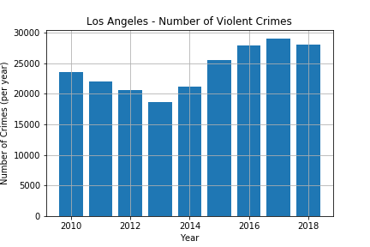
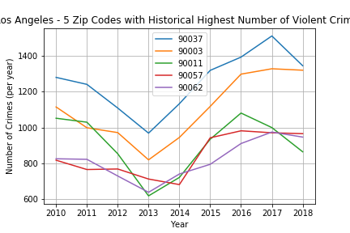
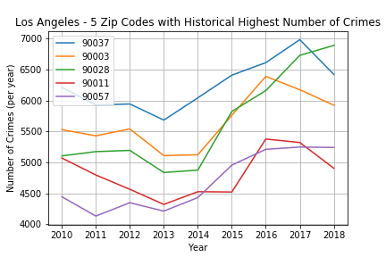
News validation
article: https://www.latimes.com/local/lanow/la-me-lapd-crime-stats-20181229-story.html
Analysis: 2018 versus 2017 from an overall violent crime perspective: from 29,045 to 27,991: decrease of 3.63 %
Article validation: In line with article 27,246 for 2018 and a decrease of near to 4 %

Slide 6
News validation: Issues
No fixed definition of what constitutes violent crime
The LA Times article describes violent crime as 'violent crime — which includes homicide, rape, robbery and aggravated assault‘
Efforts on going to classify crime (https://www.nap.edu/read/23492/chapter/7#121)
The data analysis can only be as good as the underlying data
The LA Times article states that more then 25,000 serious crimes were classified as minor
https://www.latimes.com/local/crime/la-me-lapd-audit-20151206-story.html
Overall conclusion violent crime decrease sounds good, but local stark differences
How to account for changing perception of what constitutes a crime and/or what people consider ‘normal/acceptable’ behavior over time

Slide 7
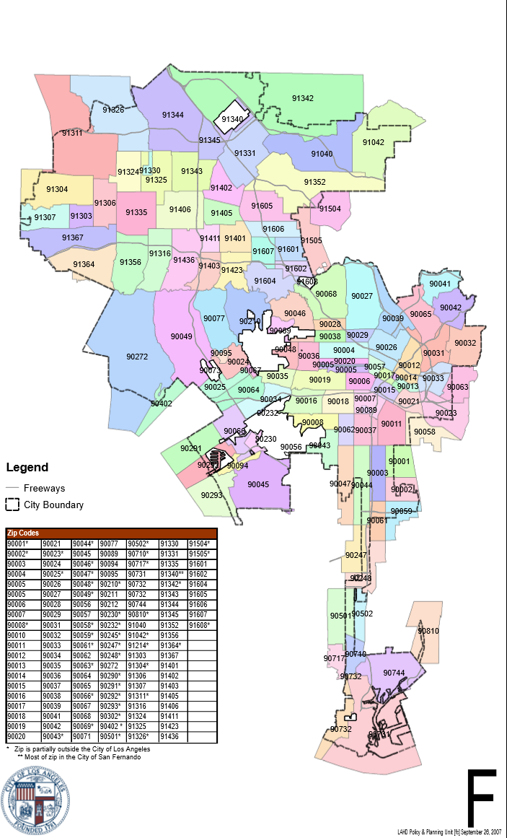
Zip Codes

Slide 8
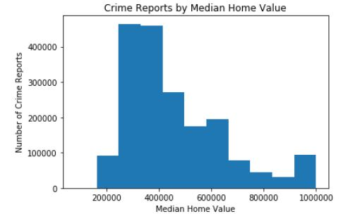
Effects of Property Values on Crime Rates

Slide 9
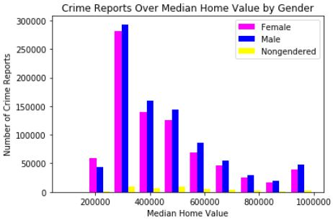
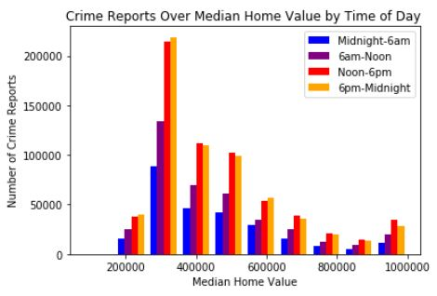
Effects of Property Values on Crime Rates: Other views

